Slide 1
SimpleITK Status
Daniel Blezek, Jesus Caban, Brad Lowkamp, Dan Muller, Fabrice de Chaumont, Julien Michel, Harvey Cline, Gabe Hart, Ghassam Hamarech, John Galeotti, Raghu Machiraju, Hans Johnson, Wes Turner, Luis Ibanez, Terry Yoo

Slide 2
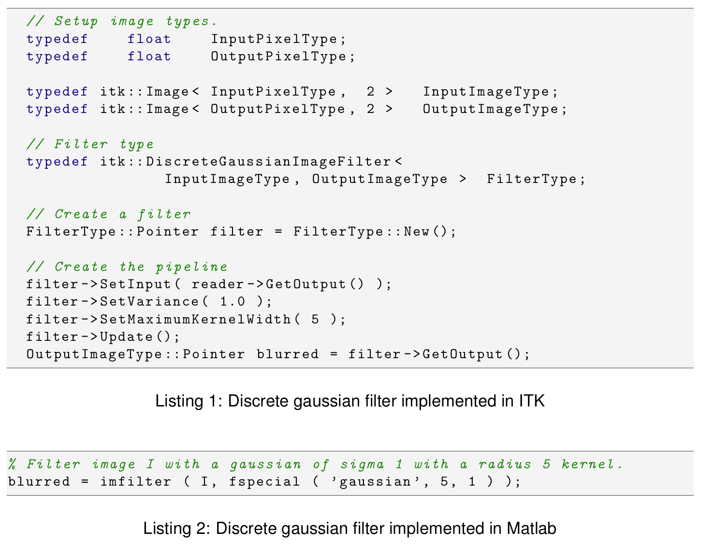
Problem

Slide 3
Complexity
Powerful but complex
Steep learning curve
Mainly C++
2 pages of GCC error messages
ITK often unused
But it’s the best...

Slide 4
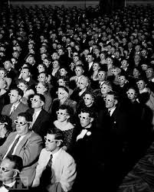
Audience
Students
Grad students
Researchers
Microscopy
Computer vision
Remote sensing
Application developers

Slide 5
Goals
Simple
“On ramp”
Wrapping
Integration
In apps
With ITK, VTK, etc
Extensible

Slide 6
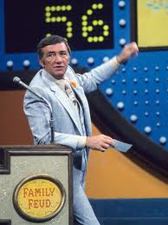
Survey Says!
214 respondents
Takeaways
Compiled packages
3D & 4D
Out of core processing
Object model
char, short, float/double, vector
Visualization
Gabe Hart

Slide 7
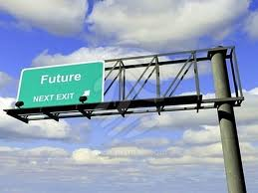
Decisions
API
Datatypes
Dimensionality
Pipeline?
Out of core processing
Wrapping
Distribution

Slide 8
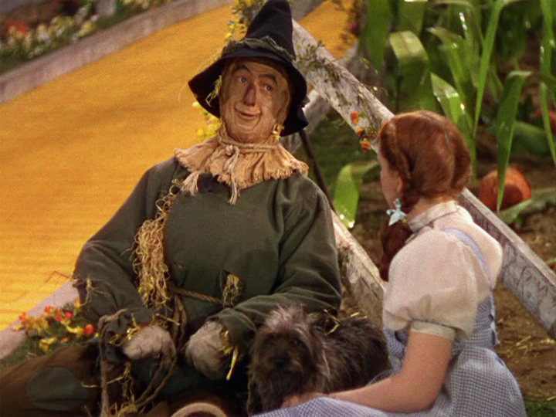
Strawman Proposal
Object model
3D images (& slice-by-slice for 2D)
4D as vector of images
char, short, float (double?)
No exposed pipeline
Out of core orchestration framework
VOI readers/writers
Call list of filters / handle boundaries
SWIG wrapping

Slide 9
API
Procedural / functional?

Slide 10
Data types
Which to support?
Scalar in all filters?
Vector in limited set?
How to support?
Dynamic loading?
Compile time configured?
Template meta programming

Slide 11
Dimensionality
3D critical
4D nice
How to support?
4D == vector of 3D images?
4D == 3D with vector pixels?

Slide 12
Pipeline
Unnecessary complexity
Utility in streaming
Not (fully) implemented in ITK

Slide 13
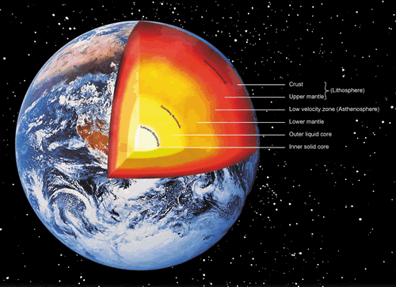
Out of core processing
Essential
ITK Pipeline?
OpenCL model?
single pixel kernel pixel
called for all

Slide 14
Wrapping
SWIG
Languages
Matlab
Python
Java
C#
Others: Tcl, R, Perl, Ruby...

Slide 15
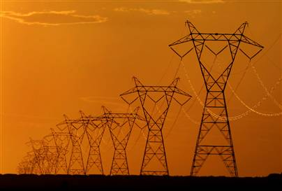
Distribution
Binary
Matlab (somehow)
Python egg
Java jar
C++ lib/dll/so & include
Source
Less useful

Slide 16
SimpleITK Status
Daniel Blezek, Jesus Caban, Brad Lowkamp, Dan Muller, Fabrice de Chaumont, Julien Michel, Harvey Cline, Gabe Hart, Ghassam Hamarech, John Galeotti, Raghu Machiraju, Hans Johnson, Wes Turner, Luis Ibanez, Terry Yoo

