Slide 1
Group 4: Web based applications/ crowdsourcing
Marcel Prastawa
Ziv Yaniv
Patrick Reynolds
Stephen Aylward
Sean Megason
Notes:
Marcel here at 2pm

Slide 2
A2D2s
SCORE: Systematic Comparison through Objective Rating and Evaluation (Prastawa):
SCORE++: Crowd sourced data, automatic segmentation, and ground truth for ITK4 (Megason):
Framework for automated parameter tuning of ITK registration pipelines (Yaniv)

Slide 3
Overall Goals
Scoring filters- segmentation, tracking, registration algorithms
Image repository – small, well curated, diverse collection with ground truth
Infrastructure – test data IO, algorithm quality dashboard, grand challenge, crowd-sourced ground truth

Slide 4
Requisite Architecture Slide
SCORE Server
MIDAS Image Repository
Scoring
Dashboard
Insight Journal
Images
Algorithms
ITK

Slide 5
New features, filters, classes
ITK Classes
ITK Reader and Writer for MIDAS
InTotoImageData3DSource for synthetic data
Scoring filters- surfaces, volumes
Parameter tuning- Nelder-Mead, Particle Swarm
Track(?)
MIDAS extensions
Image sets
SCORE : A new MIDAS instance

Slide 6
New data to be released
Number – 10 image sets
Size – large (10-100GB)
How to share – via SCORE respository
Diverse imaging modalities and image analysis challenges
Confocal, 2-photon, phase, MRI, CT, PET,

Slide 7
How data will be released
MIDAS – manual download
itkReader
Notes:
Stephen, Brad King

Slide 8
Tiers of Data
Thumbnail
Toy
Training
Challenge
Raw
Ground truth segmentation
User segmentation(?)
X

Slide 9
License
Database: Open Data Commons - Database Contents License v1.0
Image sets within Database: Open Data Commons Attribution License
Signed by PI and Harvard Office of Technology Transfer
Notes:
Luis

Slide 10
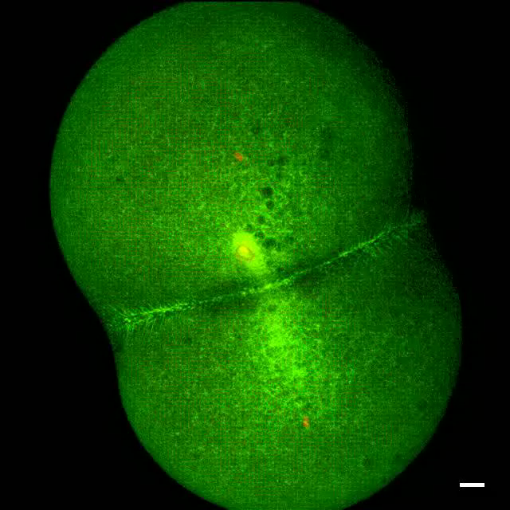
Confocal timelapse zebrafish development – segmentation and tracking

Slide 11
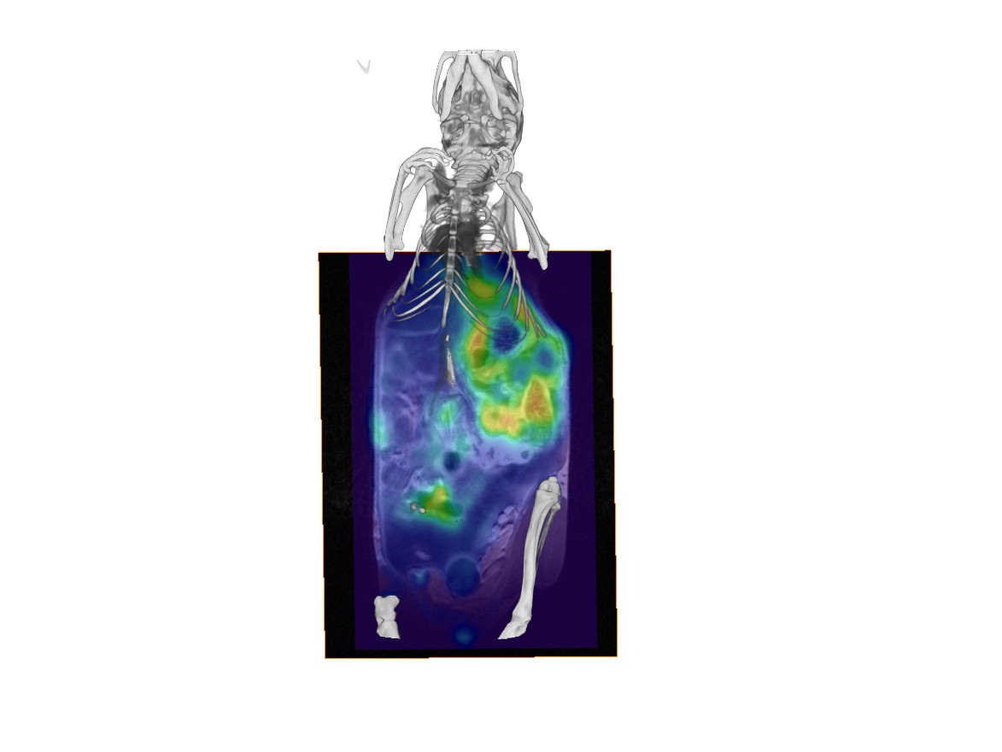
PET-MRI of mouse cancer model - segmentation and registration

Slide 12
Security
Raw Data
Upload restricted to small group for SCORE++ repository
Download – anonymous
Segmented Data (crowd source)
Upload - registered users
Download - anonymous
Challenge testing
Registered users, run on VM

Slide 13
Metadata
Must balance completeness with ease-of-use
Small set of structured data – image itself
Unstructured data as in methods section of paper – experiment, image acquisition
Biological question / image analysis challenge

Slide 14
Ground truth
Only exists for synthetic data
ImageReaderInTotoSource
Model cell shape, distribution, division
Model imaging via a microscope (PSF, noise)
Output simulated 4D image set plus ground truth

Slide 15
Manual Segmentation
Done client side using their own apps (Slicer, GoFigure…)
Label map image

Slide 16
Dashboard of Algorithms
Will show
Image set
Algorithm
Parameter
Score
Details

Slide 17
Grand Challenge Framework
Upload algorithm
ITK source code
Executable
Runs in VM with MIDAS
Scoring
Code private for scoring
Dashboard
Code published as IJ article as part of competition

Slide 18
Problems
Transfer speeds over internet
No ground truth
Parameters for segmentation filters
Parameters for scoring filters

Slide 19
Plan of action
Setup authoritative instance of MIDAS at NLM

