Slide 1
Modularization
ITK modularization status 2/2/2011
Bill Hoffman
bill.hoffman@kitware.com

Slide 2
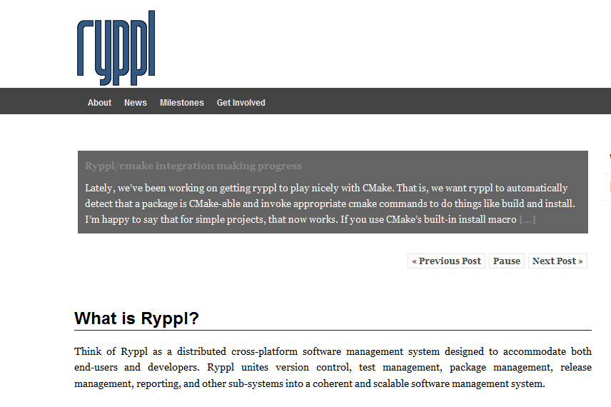
We are not alone…
Qt modularization effort
Boost modularization effort Ryppl

Slide 3
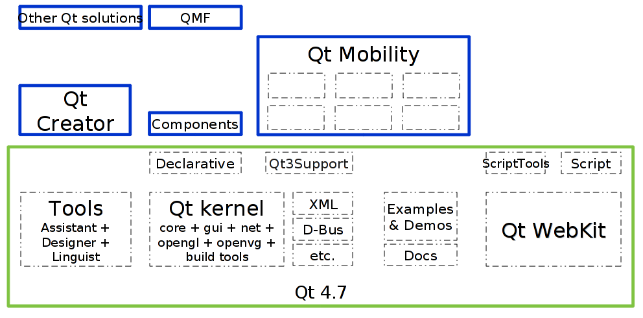
Qt

Slide 4
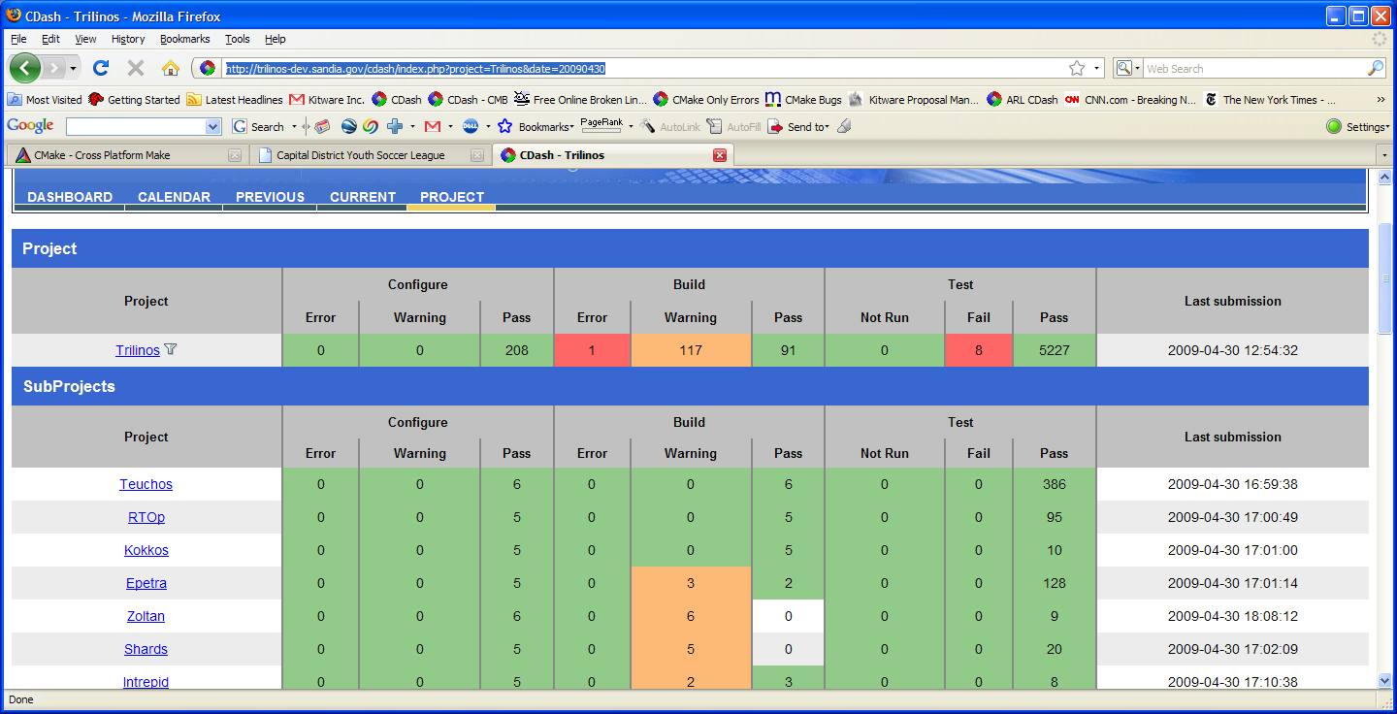
Trilinos (Multi-Package Dashboard) http://trilinos-dev.sandia.gov/cdash/index.php
Main Project
Sub Projects

Slide 5
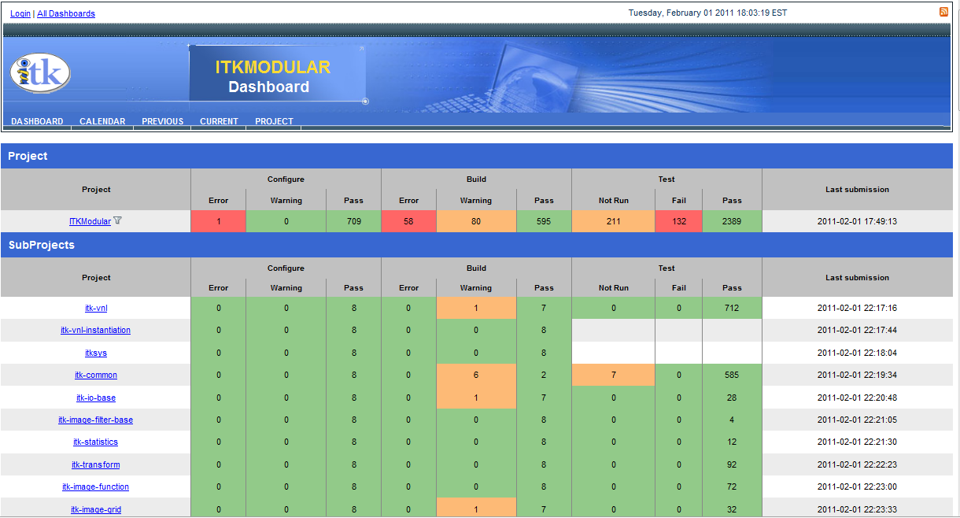
ITK Modular Dashboard!

Slide 6
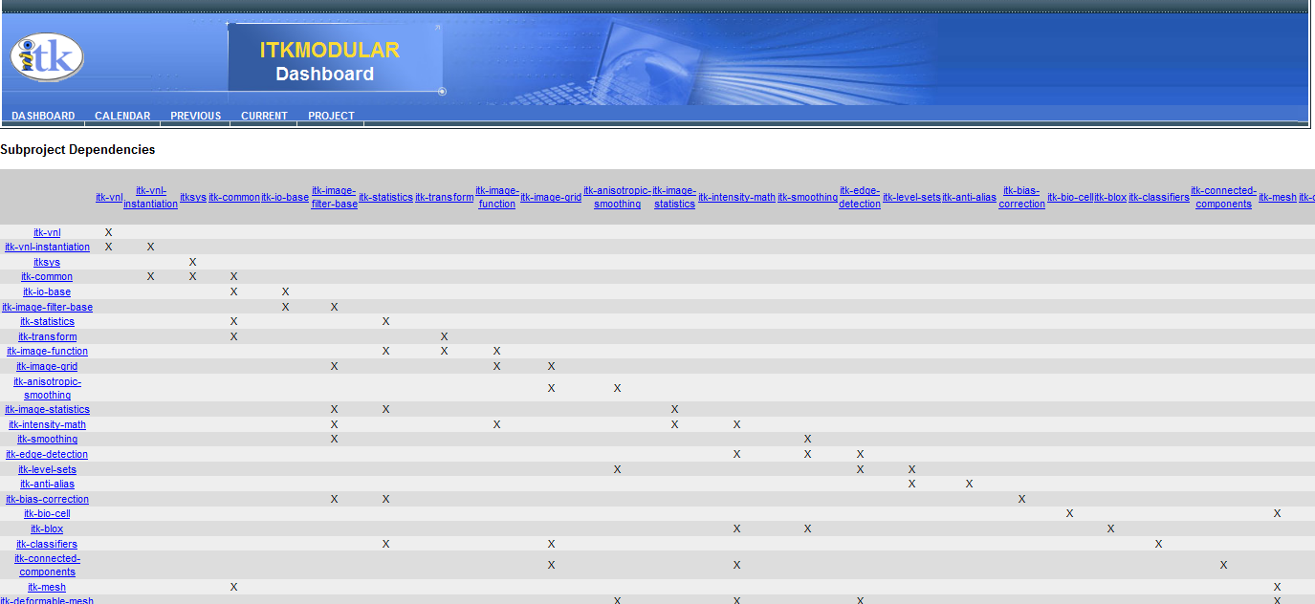
CDash view of module depends

Slide 7
Changes From November
Not using git sub-modules
Not using ExternalProject for build

Slide 8
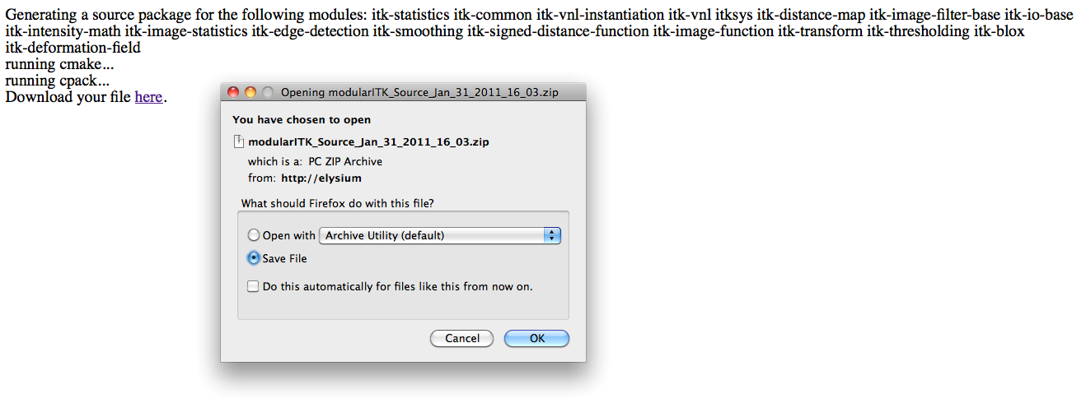
Sample PHP download page

Slide 9
Allows for Expansion Outside Main Repository
Anyone should be able to create an ITK module, and have it work in this system
Each module should contain
Source
Tests
Depend information
Documentation

Slide 10
Cool Visualization

Slide 11
ITK/Modularization directory
AddTestsWithArguments.txt
Manifest.txt
customRun.sh
testFinder.py
README.txt
modulizer.py

Slide 12
The Plan
We have a shell/python script that “modularizes” ITK
Run the script each night
Copies files into a modular ITK source tree
Modular ITK source tree is a git repo with CMake files
Dashboards for supported compilers
Get all of ITK building and in modules
Run a script to reorganize ITK in place
http://itk.org/tmp/modularITK.git
http://itk.org/gitweb?p=tmp/modularITK.git;a=commit;h=18435eb54
Mid February Date

Slide 13
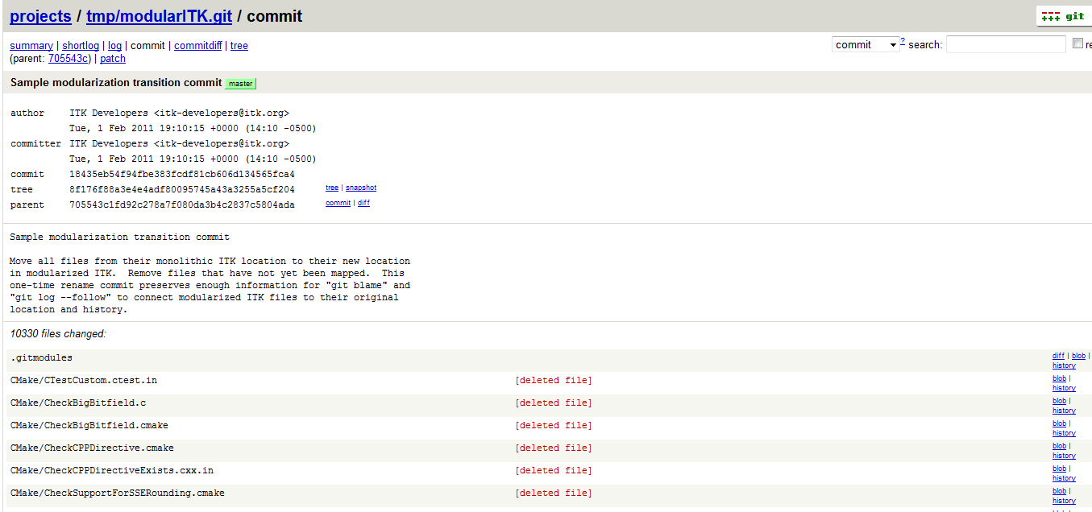
What it will look like in git

