Slide 1
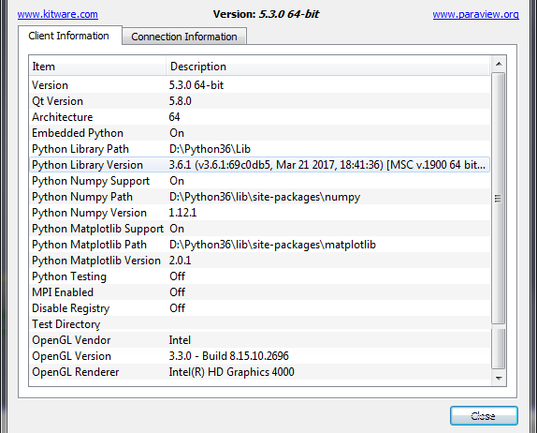
Paraview version – self compiled

Slide 2
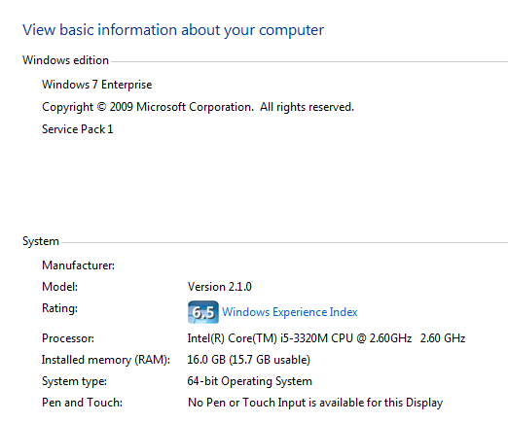
Windows system

Slide 3
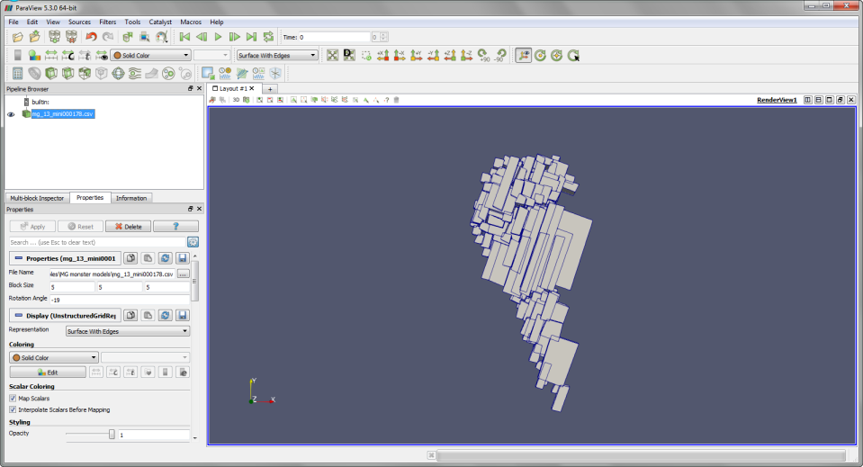
Model: unstructured grid with 178 blocks – solid shaded with edges

Slide 4
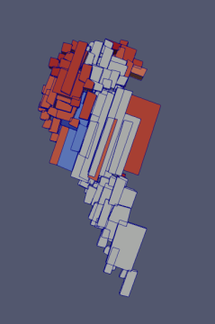
Dto with coloring according to an attribute

Slide 5
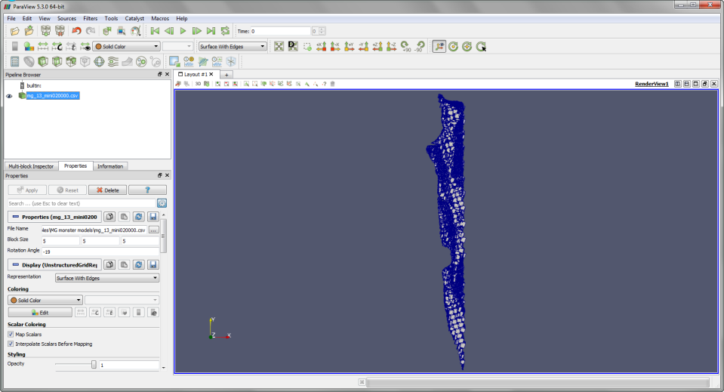
Dto with 20’000 blocks – solid shaded – surface with edges

Slide 6
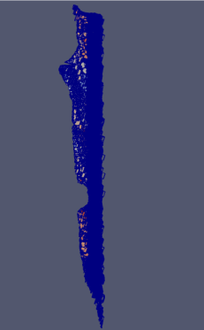
Dto colored by attribute – surface with edges
Only left part of the colored surfaces is visible

Slide 7
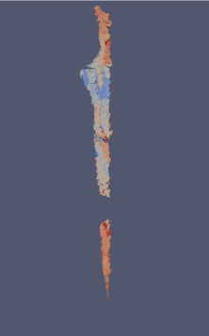
Dto – surface without edges
The effect is even better visible

Slide 8
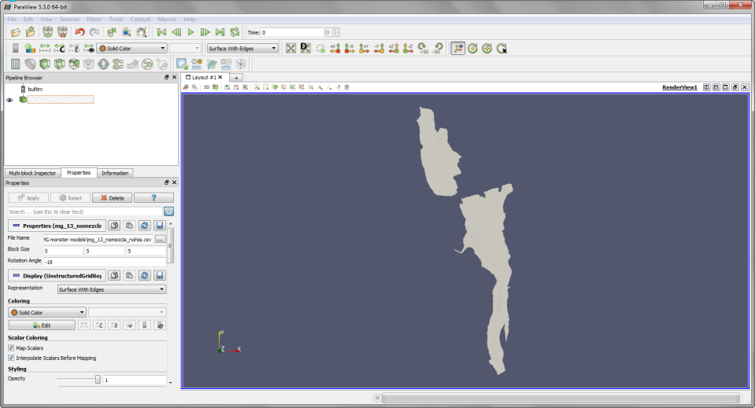
Full model (732115) – solid shaded – surface “with edges”
The edges are not visible

Slide 9
Dto colored by attribute – again surface “with edges”
Only very little left part of surfaces visible, edges are not

Slide 10
Summary
A model with 178 blocks is completely shown – solid shaded, with attribute coloring – surface with or without edges
The model with 20’000 blocks is only completely shown if solid shaded; with attribute coloring surfaces are shown only for the left part while edges are ok
The model with 732115 blocks (actually the real one – the others are just subsets) does never show the edges, and also “wireframe” shows an empty screen. However, with solid shading the surfaces are shown, while with attribute coloring only a very little part of the model is visible

Slide 11
Conclusion ??
The larger the model (number of blocks) the more parts of the display do disappear:
First the surfaces are not any more shown completely
At the end the wireframes are completely disappearing
Somehow this looks like a “not enough memory” problem
But even with the full model loaded, the task manager still reports plenty of free memory
Is there some “OpenGL memory” that is possibly limiting the model size?
Questions:
Is there anything that can be done at the level of either the block model generating plugin or within paraview?
Or is this simply a hardware problem that can only be solved with another computer?

